Slide 1


NEXT-UP Horizon Europe Project: 2nd Living Lab workshop - Emerging Insights on Youth Education–Employment Transitions, 20.04.2026
Navigating the Next Normal: Innovative Approaches to Enhancing Youth’s Education-Employment Transitions in Post-COVID-19 Europe (NEXT-UP)
Yulia Shumilova, researcher, Higher Education Group, Tampere University Yulia.Shumilova@tuni.fi

Slide 2

Next-UP
Main research Question: How can we understand and address the long-term impacts of the COVID-19 (and other emerging) crises on youth transitions from education to employment to develop future-oriented policies and practices?
5 sub-studies at macro-, meso-, micro- levels.
Living Lab as the meeting point

Slide 3

What is a Living Lab?
Living labs are user-centred, open innovation platforms based on a systematic user co-creation approach in real-life settings (ENOLL)
Living labs bring together the key stakeholders in the field - to focus on the 'wicked societal problems' (youth employability).
These problems have no single solution. LLs offer a collaborative space for integrating diverse perspectives.
Stakeholder engagement in LL is voluntary, open, and involves active dialog and feedback loops

Slide 4
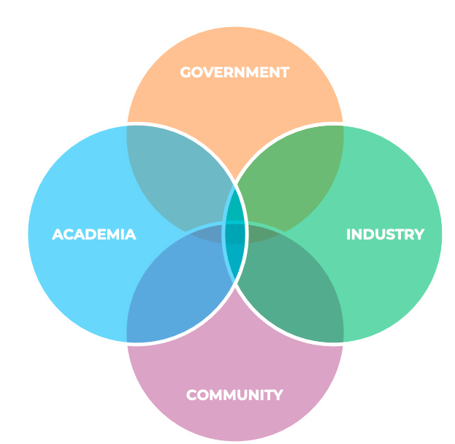
LL approach is based on Quadruple HELIX model of innovation
​bringing together the 4 groups of key stakeholders helps...
Break the silos
Speak the 'same language’
Learn from each other
Avoid overlapping efforts
Build trust and create synergies​
Co-create innovations ​

Slide 5

Next-UP Living Lab events
 | Workshop | Timing | Description
 | LL Kickoff | November, 3 | LL intro, brainstorming ideas on youth employability: challenges, opportunities and service needs in post-covid era (Hybrid)
 | Initial Findings Sharing | Apr 2026 | Initial insights from Next-UP sub-studies, stakeholder feedback (Hybrid)
 | Foresight Game | Aug/Sept. 2026 | Scenario mapping for youth employability, role play (Online/Onsite)
 | Policy Co-design | Apr 2027 | Collaborative policy design with stakeholders (Hybrid, FI) ->Policy briefs, round table with EU policy makers
 | Skills prediction/skills matching Workshop | Aug 2027 | Evidence from Machine learning and big data analysis comparing skills developed and required in job ads (Hybrid)
 | ABM Testing and kickout | Feb 2028 | Scenario testing using agent-based models (Hybrid)

Slide 6
Agenda – ppt + engagement
13.10-13.35 | What do youth employability policies have in common? - Renze Kolster, University of Twente
13.35-14.00 | Edu-labour market relations after covid: adaptation, mismatch or transformation? -Stanislav Stedronsky , Dian Liu, University of Stavanger
14.00-14.25 | Perceptions of Youth. How do young people experience their transitions, and what challenges do they perceive on their way to adulthood? - Alexandra Seehaus, Autonomous University of Barcelona
14.25-14.50 | Co-designing indicators for graduate transition to employment: What should we measure? - Teresa Carvalho, Ana Melo, University of Aveiro
14.50-15.15 | The future of skills? Is digital the answer? -Ivano Bison, University of Trento
15.15-15.30 | Closing, next steps - Yuzhuo Cai, Tampere University/Education University of Hong Kong

Slide 7
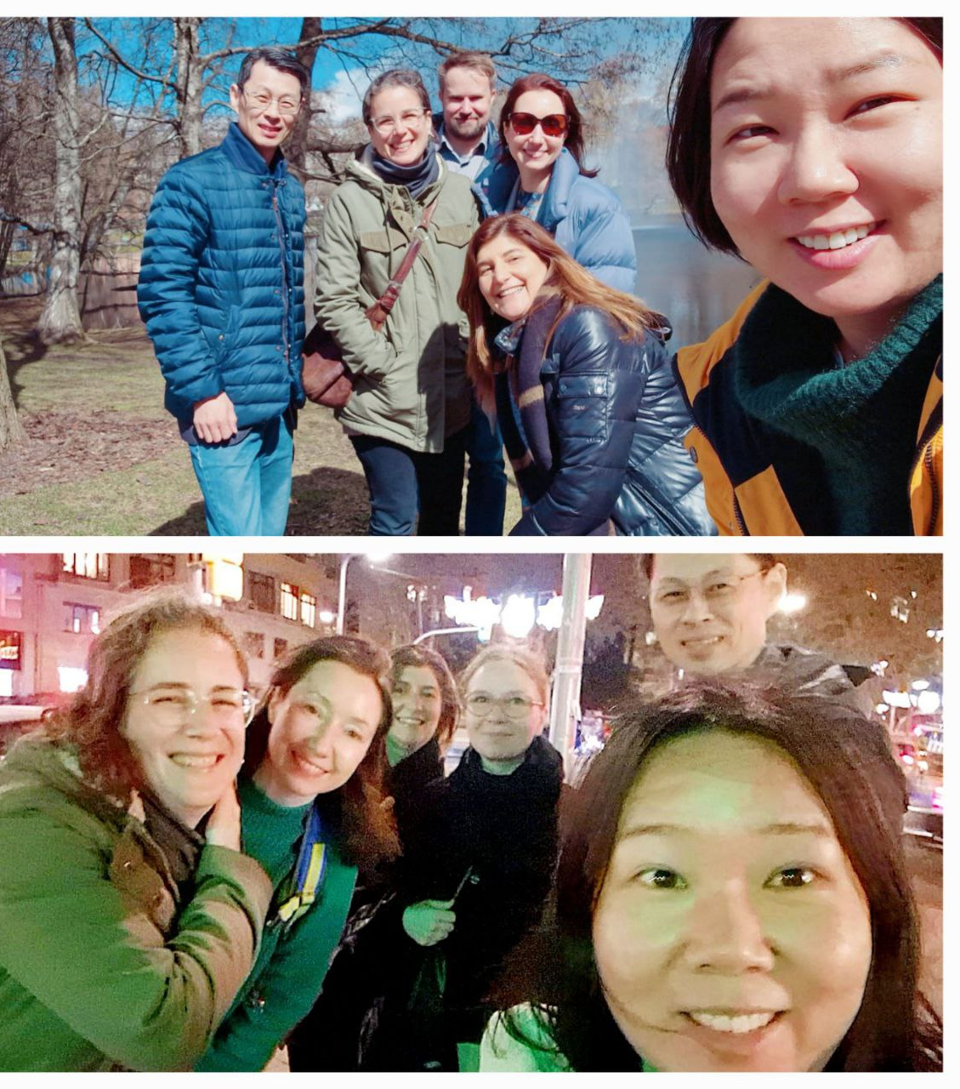
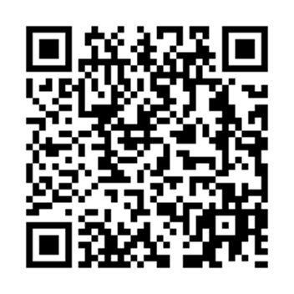

Thank you! https://www.nextup-project.eu/

Slide 8

WP4 Questions, Ivano Bison:
Is digital the problem, or is the real challenge of adapting skills to a changing labor market?
How can skills be effectively adapted to keep pace with a rapidly changing labor market?

