Slide 2
PERCEPTIONS OF YOUTH
How do young people experience their transitions and what challenges do they perceive on their way to adulthood?​

Slide 3
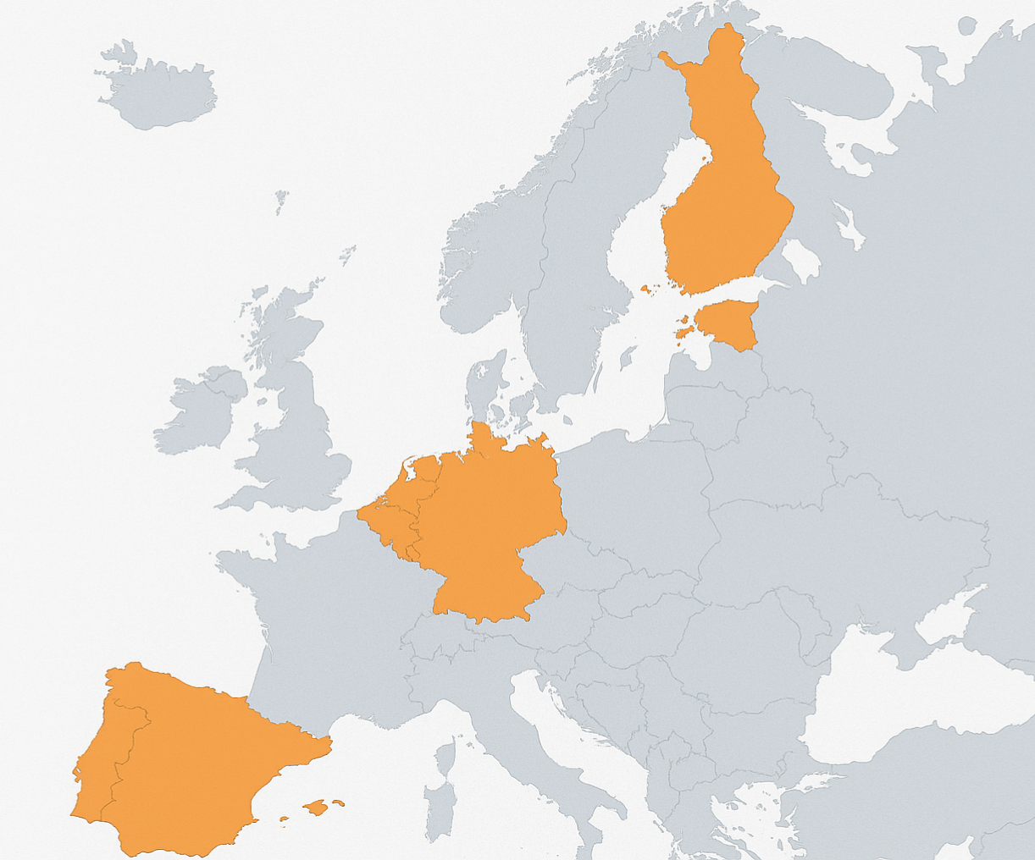
What is this WP about?
Research Questions:
How do young people experience and perceive both horizontal and vertical transitions in their lives? How does the COVID-19 crisis impact these experiences and perceptions?
What are the complexities and challenges of these transitions?
What do young people mean by “becoming adults”?
→ Precarity, preconditions for independence
Data:
125 longitudinal qualitative interviews
In: Estonia, Finland, Netherlands, Germany, Spain

Slide 4
Key Concepts
Transitions: Diversity, Reversibility, Multiplicity
Becoming an adult is no longer a linear succession of achieving adulthood markers but a complex/reversible/diverse process of becoming independent from the family of origin.
Yo-yo transitions (Biggart & Walther, 2016):
Non-linear pathways between education, work, unemployment, and back again
Extended dependency on family due to weak welfare/institutional support
Creates prolonged instability & delayed autonomy in young adulthood
More common in liberal, sub-protective, and post-socialist regimes

Slide 5
Key Concepts: Transitions
We are also comparing different youth regimes of transition from education to the labour market, if we refer to the proposal of Pohl and Walther (2007) ​
Youth regimes (NEET in %)​
Universalistic (Finland) / 10%​
Employment-centred​
Dual training (Germany) / 8,5% ​
School-based (FR)​
Mixed (NL) / 4,9%​
Liberal (IE-UK)​
Subprotective (Spain) / 12%​
Post-socialist(Mix between Liberal and Universalistic) (Estonia) / 11%​

Slide 6
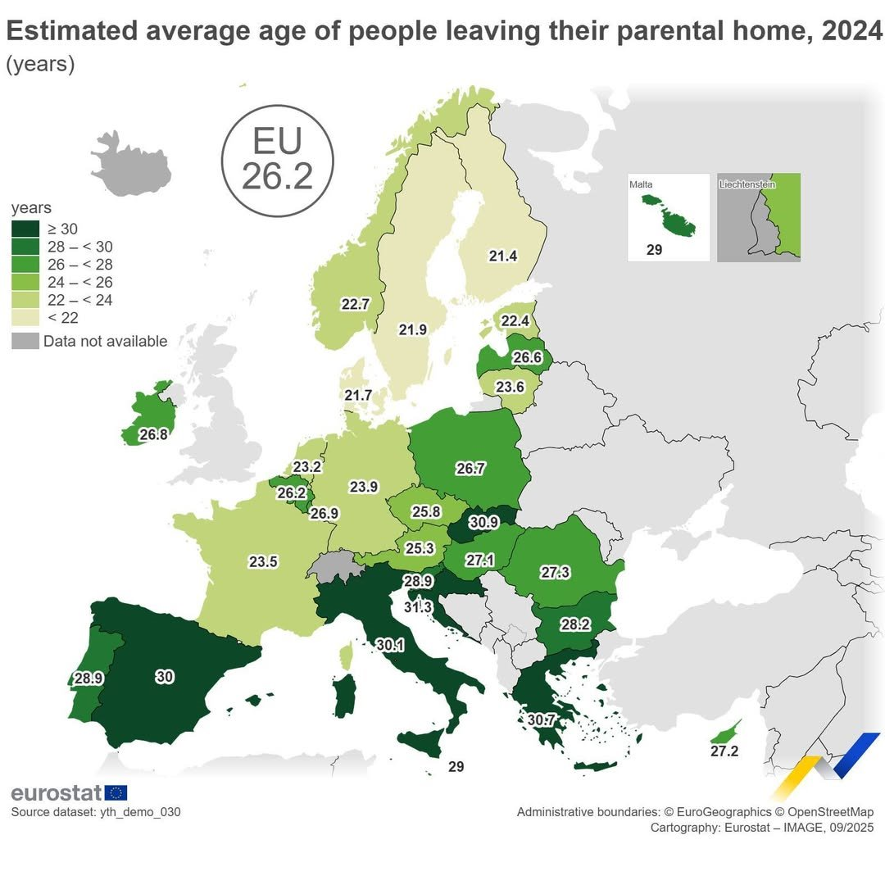
Our countries in focus:
Netherlands: 23.2
Spain: 30
Germany: 23.9
Estonia: 22.4
Finland: 21.4

Slide 7
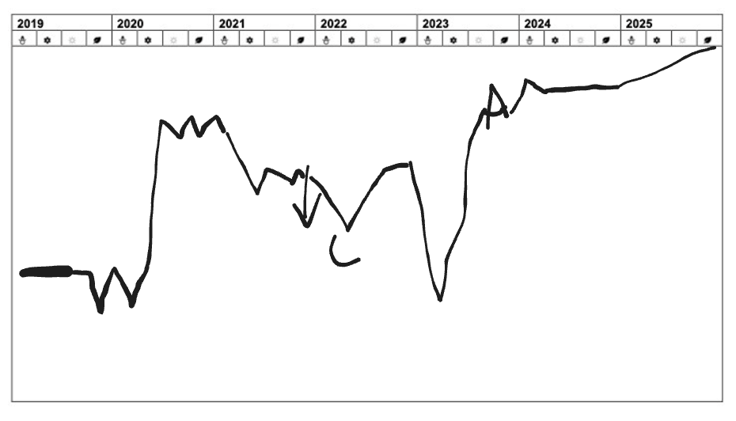
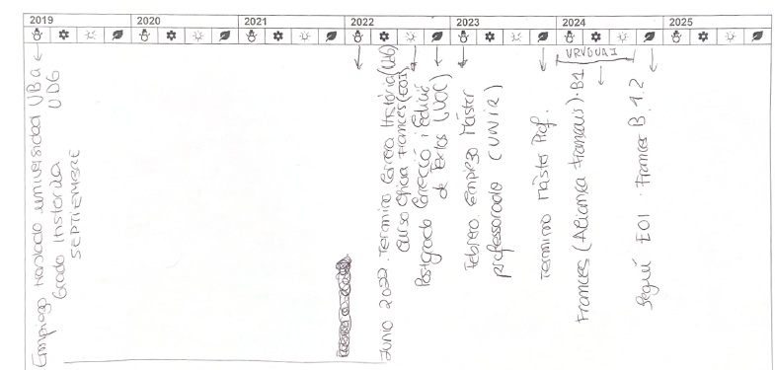
Interviews
Guideline:
Education (Can you explain to me a little bit more why you were not studying in XXX?)
Employment (What were the most difficult moments in these last years?)
Unpaid Acticities (Caring for beloved ones?)
Household and Housing (How would you describe your current housing situation?)
Adulthood (Do you feel like an adult? Why? Do you feel precarious? Why?)
Future Aspirations (Looking to the next 18 months, what do you see yourself doing?)
+ Complimentary Handouts

Slide 8
First Wave of Interviews
 | TOTAL | ISCED 2 | RURAL | MIGRATION B | W + L GLASS | ETHNIC MIN. | ILLNESS/ DISABILITY
EST | 25 | 3 | 7 | 1 | 5 | 9 | 9
FIN | 17 | 1 | 2 | 1 | 9 | 1 | 14
NTHL | 21 | 1 | 3 | - | 1 | 2 | 6
GER | 12 | - | 2 | 1 | 4 | 2 | 3
SP | 25 | 2 | 3 | 6 | 7 | 3 | 5
TOTAL | 100 | 7 | 17 | 9 | 26 | 17 | 37

Slide 9
Preliminary Findings
Reflections on the Interviews:
Varying legth of Interviews
Varying quality of handouts
Observations:
Housing and COVID, (Moving back home; housing prices)
Precarity is not necessarily perceived; focus on other things (finding out what they want, what they are good at, feeling inexperiences, lacking knowledge about contracts, rights etc.
Meaning of adulthood: being confident, having repsonsibility, being emotionally mature
Many participants, even in their late 20s, do not fully consider themselves adults

Slide 10
What surprised us or challenged our assumptions?
Translating concepts like precarity for research in different countries
Young people in Spain understand “precariedad” clearly.​
In NL, DE, EE, FI, terms like “insecurity” or “instability” are too broad.
Survey questions on inequality dimensions (gender, class, ethnicity, body discrimination, illness/disability)
Challenges in reaching vulnerable groups

Slide 11
Relevance
Rare and valuable data set that can give unique in-depth understanding of how young people perceive their transitions, what challenges them on their way to adulthood and what facilitates succesfull transitions (whatever these may look like).
Understandign better whether young people are aware of institutional support, and who can access it and benefit from it
Context sensitive and comparative knowledge
Representation of vulnerable groups in research
Translation issues - Advantages and limitations to international comparative research projects → deeper reflections needed on conceptual translations in European research

Slide 12
Next Steps
Completing the sample for the first wave of interviews and closing the last gaps (potentially oversampling some groups)
Systematically analysing the data for each country (case level, and inter-case comaprison)
Preparing country reports (by end of May)
Comparative Analysis / Country comparison

Slide 13

Discussion
Or go to: https://padlet.com/Alexandra_Seehaus/perceptions-of-youth-how-do-young-people-experience-their-tr-8ky1tjg9tzbf02uu

Slide 14
Discussion
What do you think young people aspire to for their lives and adulthood?
From your expertise, how would you define adulthood?
From your expertise, what do you see as the most important challenges and facilitators for young people during their transitions?

